Slide 1



SENTIMENT ANALYSIS ON IMDB MOVIE REVIEWS USING LSTM
Presented by:
Aman Niyad 2105438
Prajukta Dey 21052263
Subarna Sutradhar 21052288

Slide 2

Contents
1
Introduction to Sentiment Analysis
2
Dataset Overview
3
Model Architecture
4
Training Process
5
Model Evaluation

Slide 3
Contents
6
Results
7
Prediction on Sample Sentences
8
Conclusion

Slide 4
Introduction to sentiment analysis
Definition: Sentiment analysis is the process of analyzing digital text to determine if the emotional tone of the message is positive, negative, or neutral.
Importance:
Provides valuable insights into public opinion and consumer sentiment.
Enables businesses to understand customer feedback and adapt strategies accordingly.
Applications:
Social media monitoring: Analyzing trends and sentiments across platforms.
Product reviews analysis: Evaluating customer satisfaction and product performance.
Movie reviews analysis: Discerning audience reactions and predicting box office success.

Slide 5
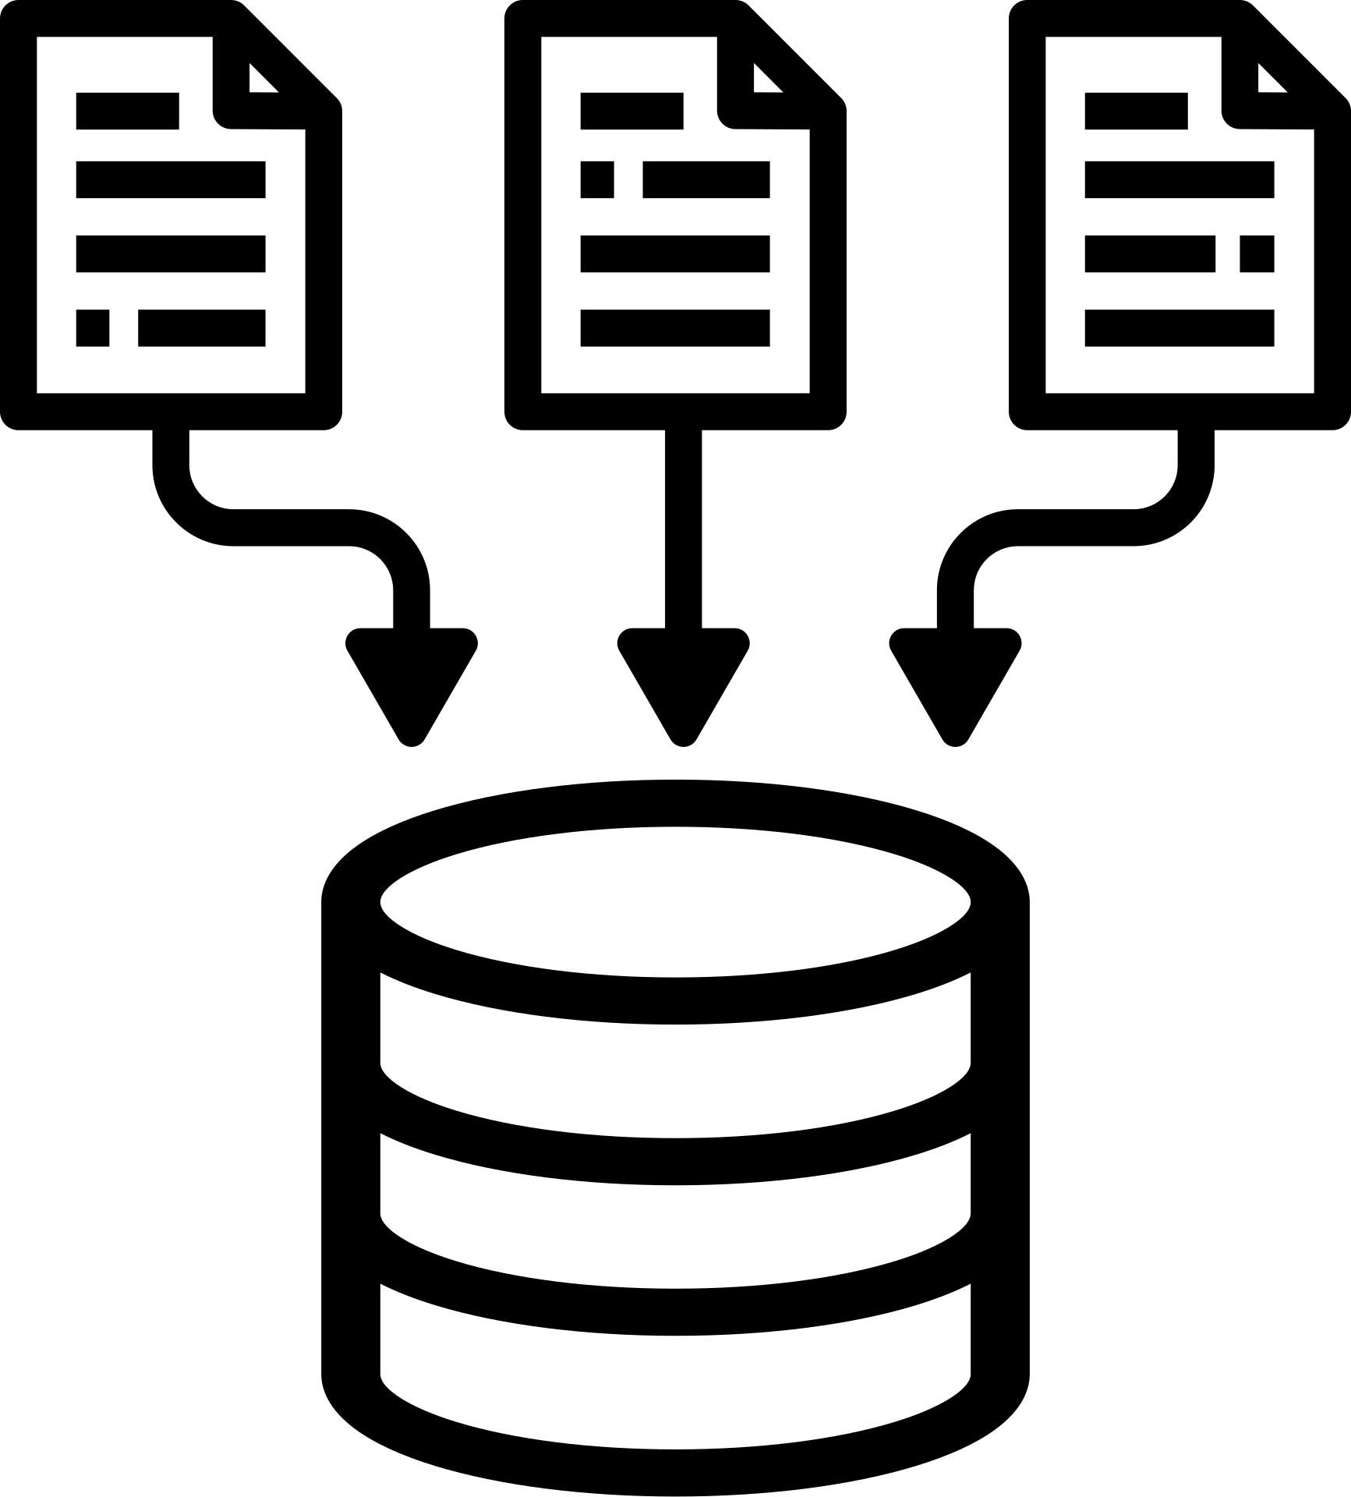
Dataset Overview
IMDB Movie Reviews Dataset:
Contains 50,000 movie reviews for natural language processing (NLP) or text analytics.
It is ideal for binary sentiment classification tasks.
Significantly larger than previous benchmark datasets, offering extensive data for analysis.
Dataset Composition:
Training Set: 25,000 highly polar movie reviews.
Testing Set: Another 25,000 reviews for evaluation.
Objective:
Predict sentiment labels (positive or negative) using classification or deep learning algorithms.
Additional Information:
For more details about the dataset, visit: the IMDB Movie Reviews Dataset

Slide 6
Model Architecture
LSTM (Long Short-Term Memory) Neural Network:
Long-Term Dependency Capture:
Input Representation:
Output: Binary Sentiment Classification:
Utilizes word embeddings, representing words as dense vectors in a continuous space.
These embeddings can be pre-trained on large corpora to capture semantic similarities or trained from scratch alongside the model.
The model outputs a binary classification indicating the sentiment of the input text.
Predictions are categorized into either positive or negative sentiment, enabling intuitive interpretation of results.
LSTM cells excel at capturing long-term dependencies within sequential data, making them particularly effective for analyzing text data where contextual understanding is crucial.
Utilizes LSTM cells, a specialized type of recurrent neural network (RNN), renowned for their capability to retain and utilize information over long sequences.

Slide 7
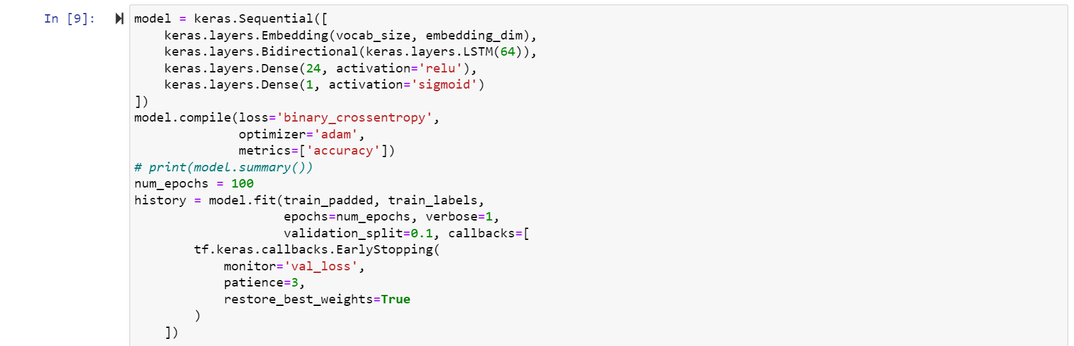
Training Process
Model Architecture:
Sequential model comprising several layers for sentiment analysis.
Starts with an Embedding layer to convert input sequences into dense vectors.
Utilizes a Bidirectional LSTM layer with 64 units to capture bidirectional context.
Incorporates two Dense layers for feature extraction and final sentiment classification.
The final layer uses sigmoid activation for binary sentiment prediction.
Compilation:
Configured with binary cross-entropy loss function for binary classification.
Employs the Adam optimizer for efficient gradient descent during training.
Monitors accuracy as the evaluation metric to assess model performance.

Slide 8


Training Process
Training Process:
Trains the model for 100 epochs on the training data.
Validation split of 0.1 ensures model performance monitoring on a portion of the training data.
Early stopping callback halts training if validation loss does not improve for 3 consecutive epochs, restoring the best weights.
Summary:
The model undergoes iterative training, adjusting its parameters to minimize loss and improve accuracy.
Adaptive early stopping prevents overfitting, ensuring optimal generalization on unseen data.

Slide 9
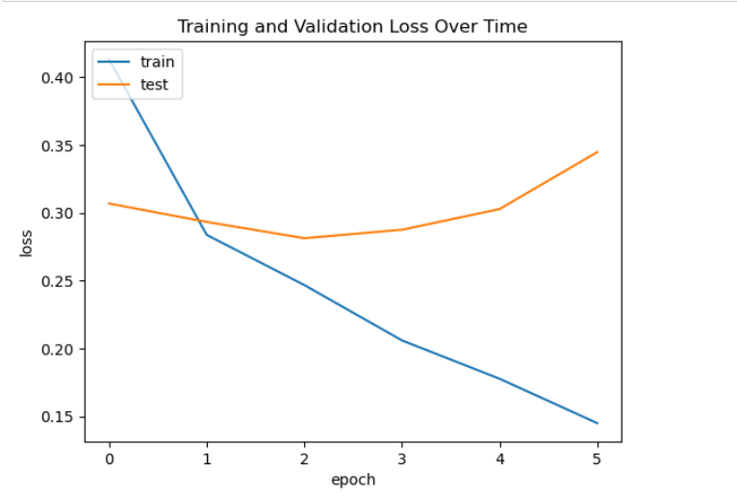
S
Model Evaluation
The graph depicts how the training loss and validation loss of a machine learning model behave over time (epochs).
Shows a line graph of training and validation loss over time. The text labels on the y-axis are cut off, but it appears to be loss and the x-axis is labeled epoch.

Slide 10
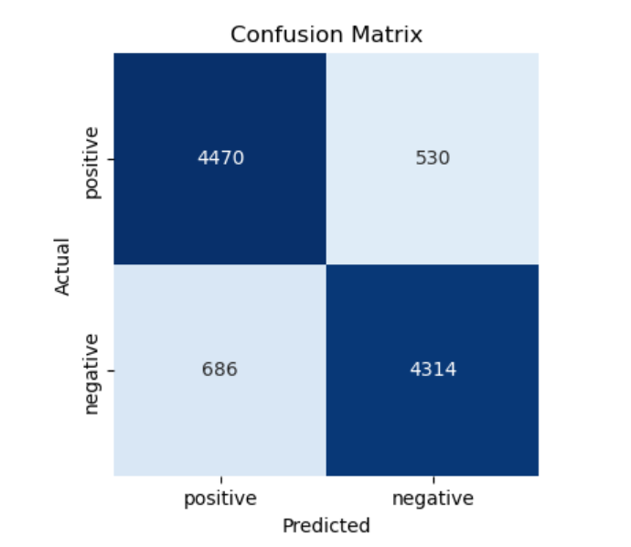
S
Results
The confusion matrix you provided appears to be a 2x2 table because it's a binary classification problem (positive or negative sentiment).
Rows: Represent the actual sentiment labels of the test data.
Columns: Represent the sentiment labels predicted by the model.
Diagonal Cells (Top Left and Bottom Right): Represent the number of correct predictions. (Correctly classified positive and correctly classified negative).
Off-Diagonal Cells (Top Right and Bottom Left): Represent incorrect predictions. (False positives - negative examples classified as positive, and False negatives - positive examples classified as negative).

Slide 11

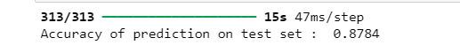
Accuracy
Accuracy: A metric that represents the proportion of correct predictions made by a model. In this case, an accuracy of 0.8784 signifies that the model correctly classified 87.84% of the examples in the test set.

Slide 12
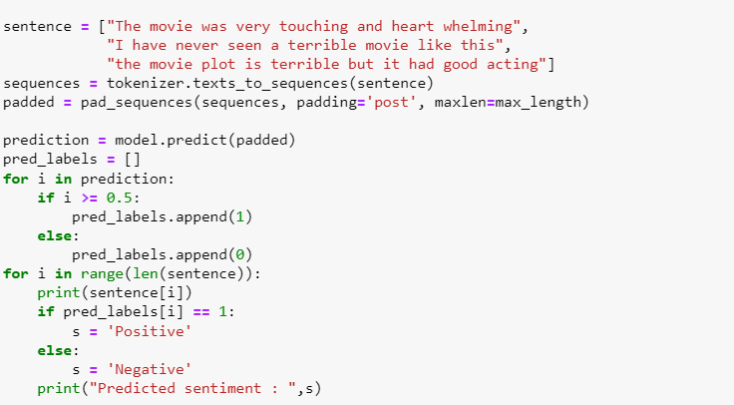
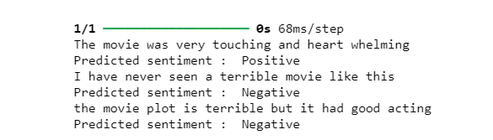
Prediction on Sample Sentences
Prepare the Sentences:
We define example movie review sentences (sentence).
A tokenizer (tokenizer) converts the sentences into numerical sequences the model understands (sequences).
Padding (pad_sequences) ensures all sequences have the same length (padded), a requirement for the model.

Slide 13
Prediction on Sample Sentences
Sentiment Prediction with the Model:
The model (model.predict(padded)) predicts sentiment labels (positive or negative) for the prepared sentences.
Interpreting Predictions:
We iterate through the predictions and create a list (pred_labels) to store the predicted sentiment (1 for positive, 0 for negative) based on a threshold of 0.5.
Finally, we print the original sentences along with their predicted sentiment ("Positive" or "Negative").

Slide 14
Conclusion
Future Directions:
Dataset Expansion: Explore larger and more diverse datasets to enhance model generalization and mitigate bias.
Model Refinement: Experiment with alternative architectures, such as attention mechanisms or transformer models, to further improve sentiment analysis performance.
Multimodal Analysis: Integrate additional data modalities, such as movie trailers or user ratings, to enrich sentiment analysis insights and provide a more comprehensive understanding of audience sentiment.

Slide 15




